Slide 1

Team : The DataMiners
[ Ramnivas Singh, Deepak Sharma, Tage Singh, Richard Zheng, Matthew Lucich ]
Dated : 03/19/2021
Most Valued Data Science Skills

Slide 2
What are Most Valued Data Science Skills ?

Slide 3
Summary
Data science primarily uses a combination of analytics and problem-solving skills
Data science methodologies are used extract knowledge and other insights from the data
The role of Data science is integral in many fields, key business are taking advantage of it
Purpose of this project is to identify the most valued data science skills, as a team, we will analyze the data set to identify some important skills
We have chosen a dataset to discover what are the most valued skills used in Data Science while working in a virtual team
Team has applied practical collaboration, knowledge sharing, data analysis and problem solving skills on the dataset
Team has used industry tools such as Google Trends, AWS RDS, S3, R Studio for data analysis & validations

Slide 4
Project Team – ‘The DataMiners’
 | Role | Responsibilities
Ramnivas Singh | Data & Analytics Lead | Data science & Analytics execution of task with the team Catalyst to resolve impediments which arises during this project
Deepak Sharma | Data Scientist | Understand the challenges, offer the solutions using data analysis Data Transformation, cleansing and visualization expert
Richard Zhou | Data Scientist | Data sourcing, cleansing, modeling of structured data Data Transformation, visualization and predictive analysis
Tage Singh | Data Architect | Data Architecture, ER Diagram and data management Cloud enablement, Integrations and Data Security
Matthew Lucich | Data Modeler & Statistician | Understand and translate analysis questions into data models Insights from the data set, create data strategies for project

Slide 5
Tools & Technologies
These tools and technologies are used throughout the project to accomplish key aspects of the project
Team Communication
Code Sharing & Quality
Project Documentation
Data Load & Cleansing
Data Mining & Analysis
Slack
Zoom
Outlook
Phone / Text
GitHub
AWS RDS
code-inspector
MS Excel
MS PowerPoint
Rpubs
Workbench Reverse Engineering
.CSV import
R Data Import
AWS S3
Google Trends
AWS RDS
dployr
tidyr

Slide 6
Data Source & Loads
Data to Collect
Job listing data with attributes including: job title, job description, salary, company, location
Collected in last 2-3 years
Data Location
Web scraped data from Indeed job descriptions is hosted on Kaggle
Data location: https://www.kaggle.com/elroyggj/indeed-dataset-data-scientistanalystengineer?select=indeed_job_dataset.csv
Load Data
Load Kaggle CSV into Amazon RDS database via the “LOAD DATA INFILE” statement
  Specify appropriate values for “FIELDS TERMINATED BY”, “ENCLOSED BY”, “LINES TERMINATED BY” and other statements related to data formatting
Once inserted into RDS, load data into project’s R markdown file by connecting to AWS database through the R package: RMySQL
  Utilize dbplyr’s in_schema function to access tables using non-default schema
  Utilize base R’s as.data.frame function to coerce results to dataframe
Credentials will be read from our environment variables for improved security

Slide 7
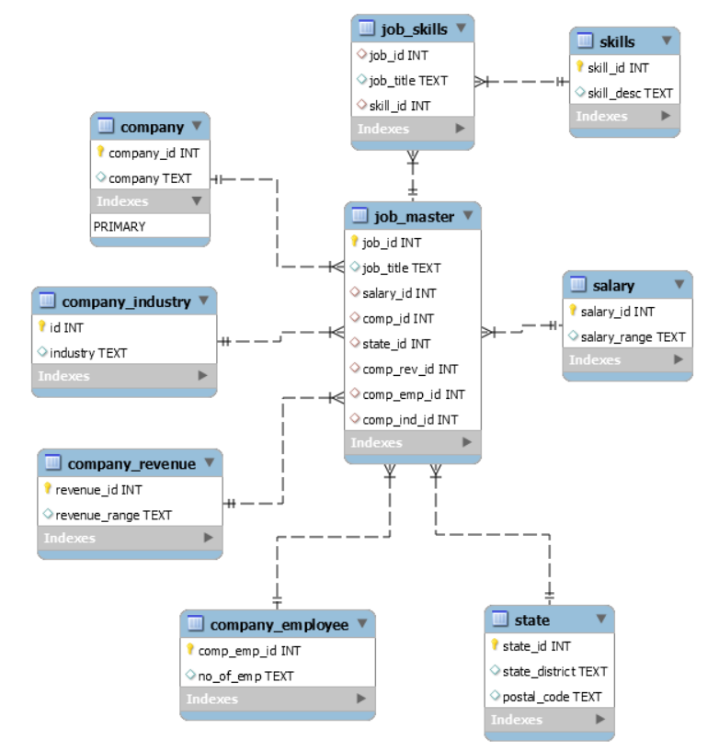
Database Design
Entity Relationship (ER) Diagram
Database Objects & Provider
job_skills : This table keep required job skills for a job posting
skills : This table is used to retain a master list of the skills
salary : This table keep salary mentioned on a job posting
state : State for which this job is posted
job_master : This is a key table to retain job details.
This key table for data analysis
company_employee : To retain employee count of job posting company
company_revenue : To retain total revenue of job posting company
company_industry : To keep business industry of job posting company
company_revenue: Name of the company posting data science job
view_d607_p3_all_recs: view to return complete data normalized data
Provider : Amazon Web Services (AWS) RDS
Database Host : data607-project3.cbs1lxtno2zh.us-east-2.rds.amazonaws.com
Database Port : 3306
Database Security : IP Based Access, VPC security groups
Password Management : laresbernardo/lares package

Slide 8
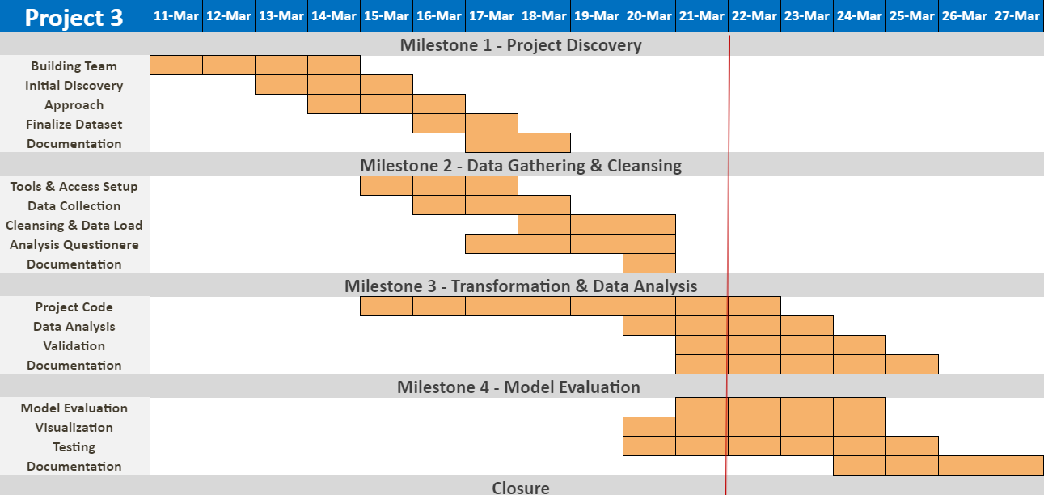
Approach & Execution

Slide 9
Team to deliver….

Slide 10
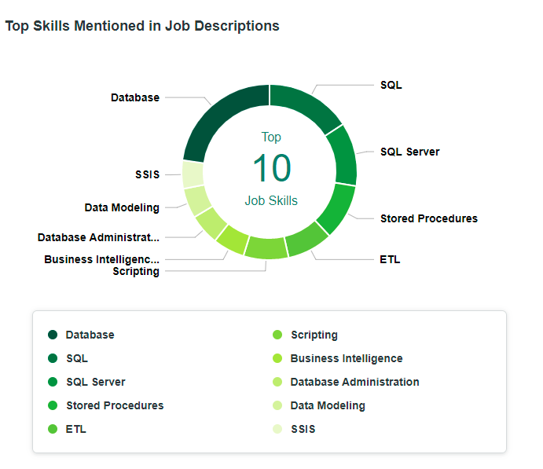
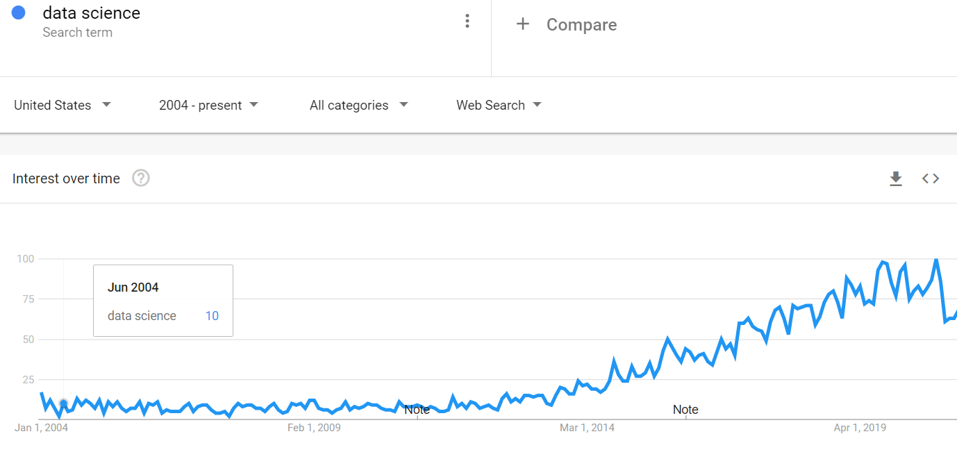
Data Analysis
What are soft Skills
Are Data Science Soft Skills unique to this type of work
What about Data Science Managers, are their soft skills requirement unique or are they similar to other managerial soft skill sets in tech?
What are important skills for Data Science
Do important skills vary by location, experience, salary?
How has the interest for skills changed over time?

Slide 11
Trends & modeling
Google Trends
For top skills, filtered on various attributes (e.g. salary, location, etc.), Google Trends will be scraped
Data will be analyzed to determine:
  What skills and technologies have increased in popularity over time?
  What skills and technologies have decreased in popularity over time?
  What skills and technologies have remained stable in popularity over time?
Modeling
Modeling section will include 1-2 approaches to be determined, which may include:
  Regression
    Predict salary based on:
      Skills
      Years of experience
      Location
  Clustering
    Is interest in skills and technologies clusterable by:
      Years experience
      Top companies (by revenue)
      Top industries (by count)

